Slide 2
Class 22
Tasks: Debugging ML

Slide 3
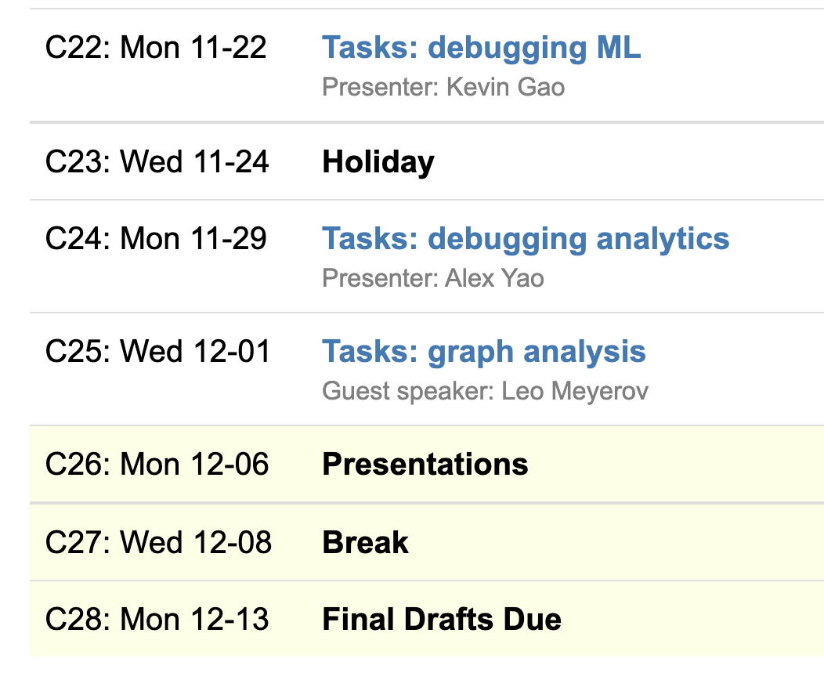
Logistics
Student & guest classes
Showcase on 12/6

Slide 4
Showcase Logistics 12/06
9(!!) groups
Each team: 5 min presentation, 3 min feedback
Every team member should speak
Timing is strict, so practice!

Slide 5
Presentation Slides Submission
Submit slides via Google form (TBA)
Google slides strongly preferred
Each team submits once
Deadline for slide submission
Friday, 12/03/2021 11:59 PM

Slide 6
Showcase Details
Presentation should contain (in substance, not necessarily slides)
Motivation and hypotheses
Technical challenge and contribution
Related work and how they are related
Simple example to illustrate idea
Technical insights/experimental findings so far
Demos as GIFs or embedded videos
Feedback: 1-2 questions you’d like feedback on

Slide 7
Class 20
Tasks: Events

Slide 8
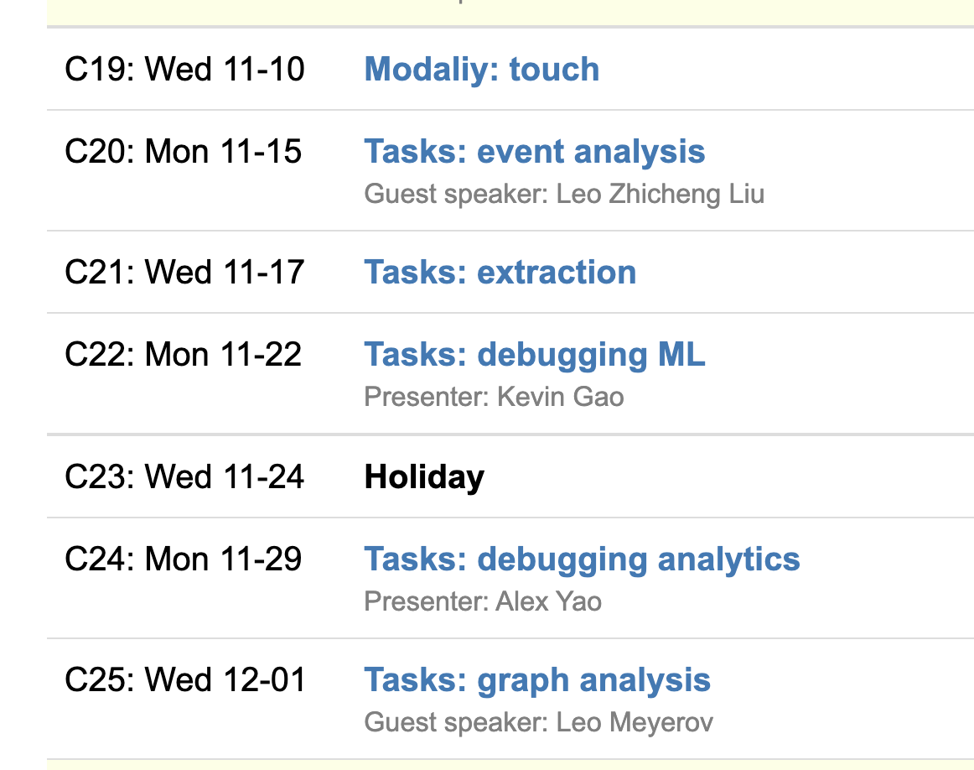
Logistics
A4 due Tuesday 11:59PM EST
Student & guest classes after Weds
Showcase on 12/6

Slide 9
A4
Run locally using duckdb
https://github.com/columbiaviz/dbt-assignment

Slide 10
Reviews
Harassment in video game chat rooms
Software product user evaluation
Fantasy Football
Story writing
Log analysis
Fried chicken TV ads
TCP/IP analysis
On-call incident analysis
Finance
Social network tracking
NLP

Slide 11
Showcase Logistics 12/06
9(!!) groups
Each team: 5 min presentation, 3 min feedback
Every team member should speak
Timing is strict, so practice!

Slide 12
Presentation Slides Submission
Submit slides via Google form (TBA)
Google slides strongly preferred
Each team submits once
Deadline for slide submission
Friday, 12/03/2021 11:59 PM

Slide 13
Showcase Details
Presentation should contain (in substance, not necessarily slides)
Motivation and hypotheses
Technical challenge and contribution
Related work and how they are related
Simple example to illustrate idea
Technical insights/experimental findings so far
Demos as GIFs or embedded videos
Feedback: 1-2 questions you’d like feedback on

Slide 14
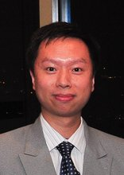
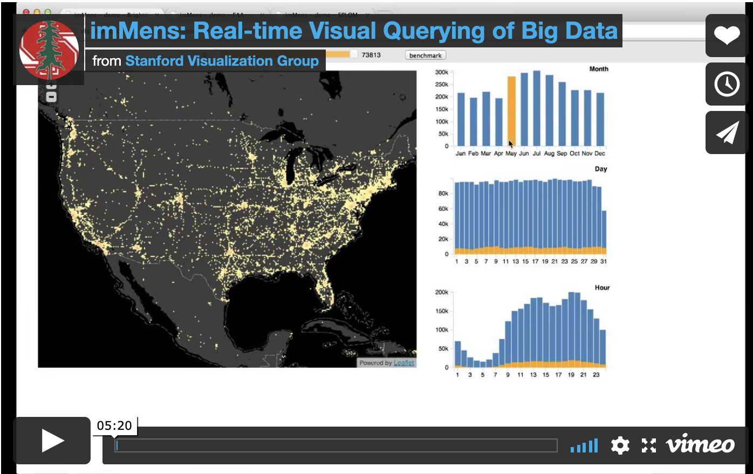
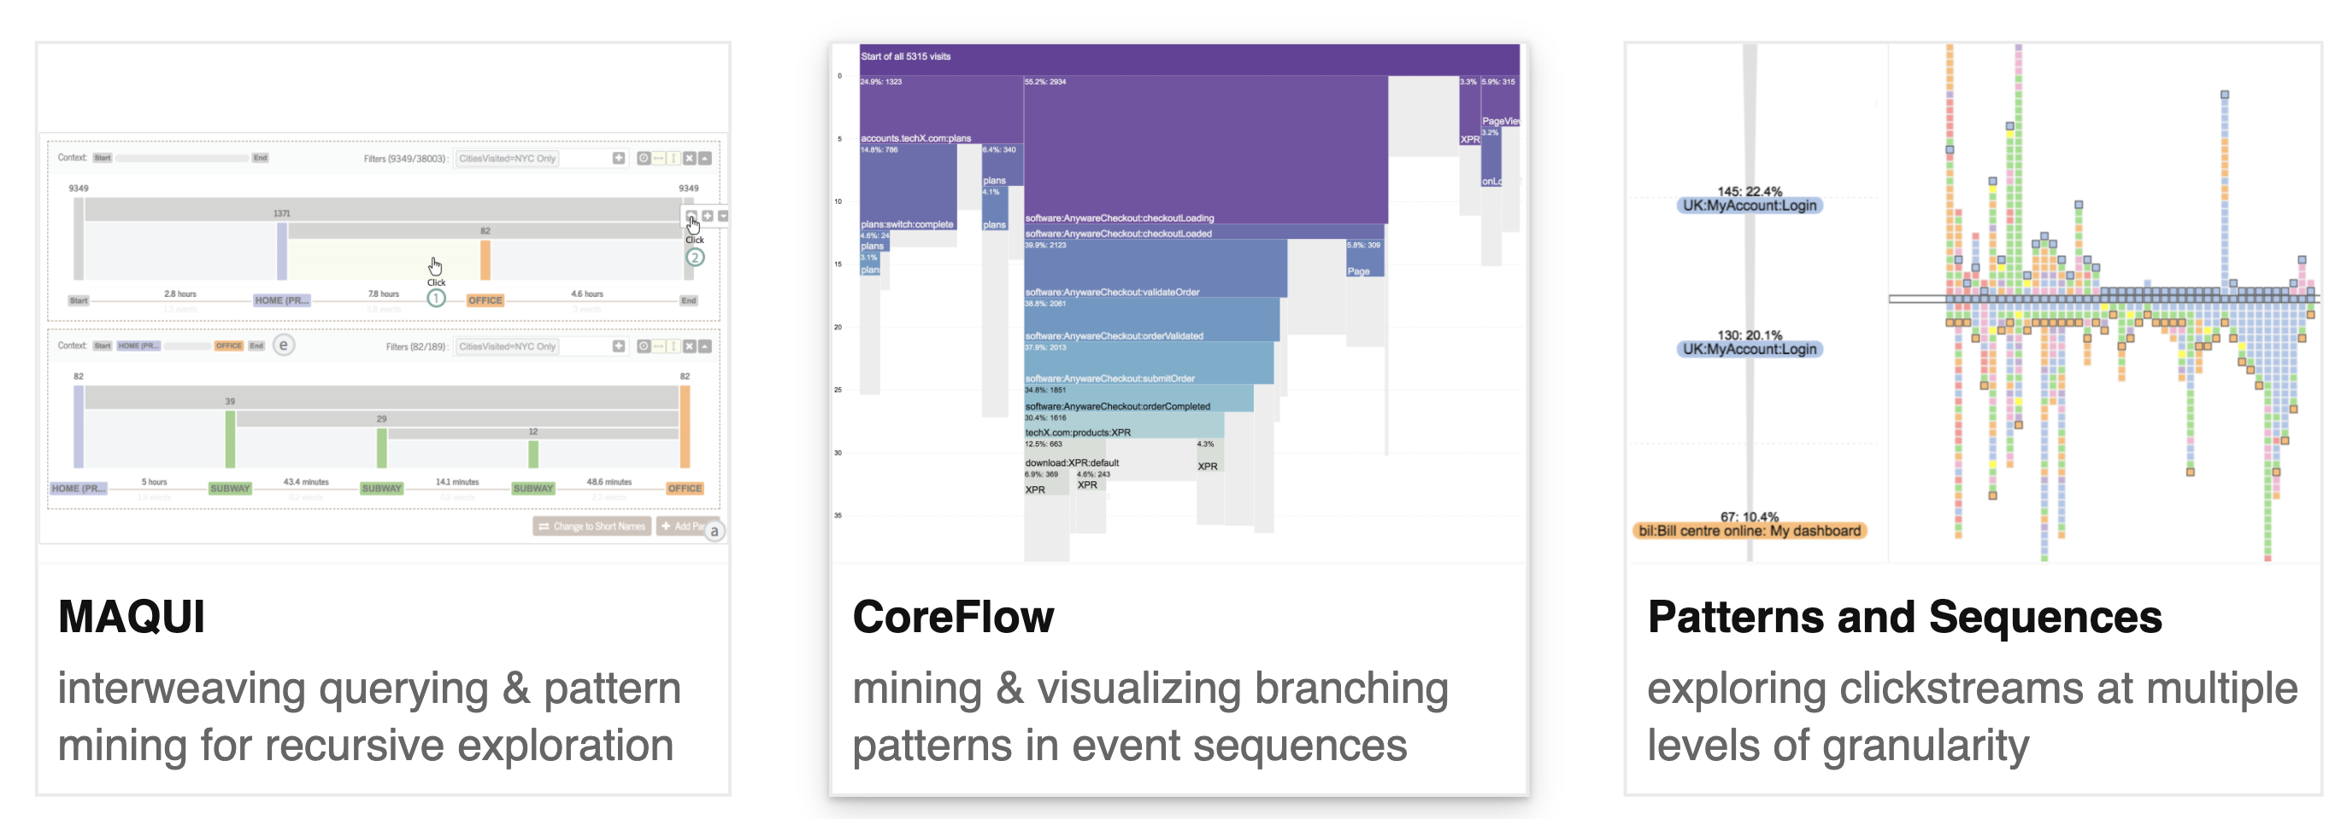
Leo Zhicheng Liu U Maryland, College Park

Slide 15
Class 16
Modalities: Spreadsheets

Slide 16
Logistics
If you are sick, talk to me to arrange a special-case zoom
A4 released later today (use #A4 channel on slack)

Slide 17
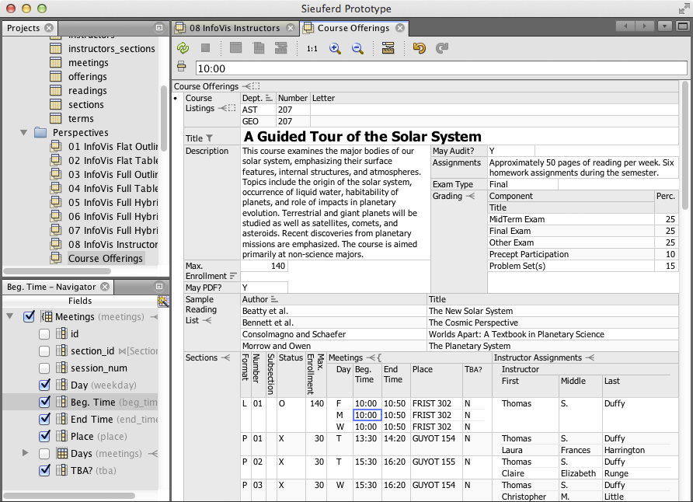

Eirik Bakke: Spreadsheets

Slide 18
Each group assigns notetaker
Our model of HDIs is based on language (expressiveness), task, visual representation, and interactions.
Contrast two spreadsheet systems from A3 in terms of our model.
Notes:
How did you pick the other vis language?

Slide 19

Support your colleagues
for speaking up!

Slide 20
Each group assigns notetaker
Our model of HDIs is based on language (expressiveness), task, visual representation, and interactions.
Contrast two spreadsheet systems from A3 in terms of our model.
Notes:
How did you pick the other vis language?

Slide 21
Class 15
Modalities: Voice and Text

Slide 22
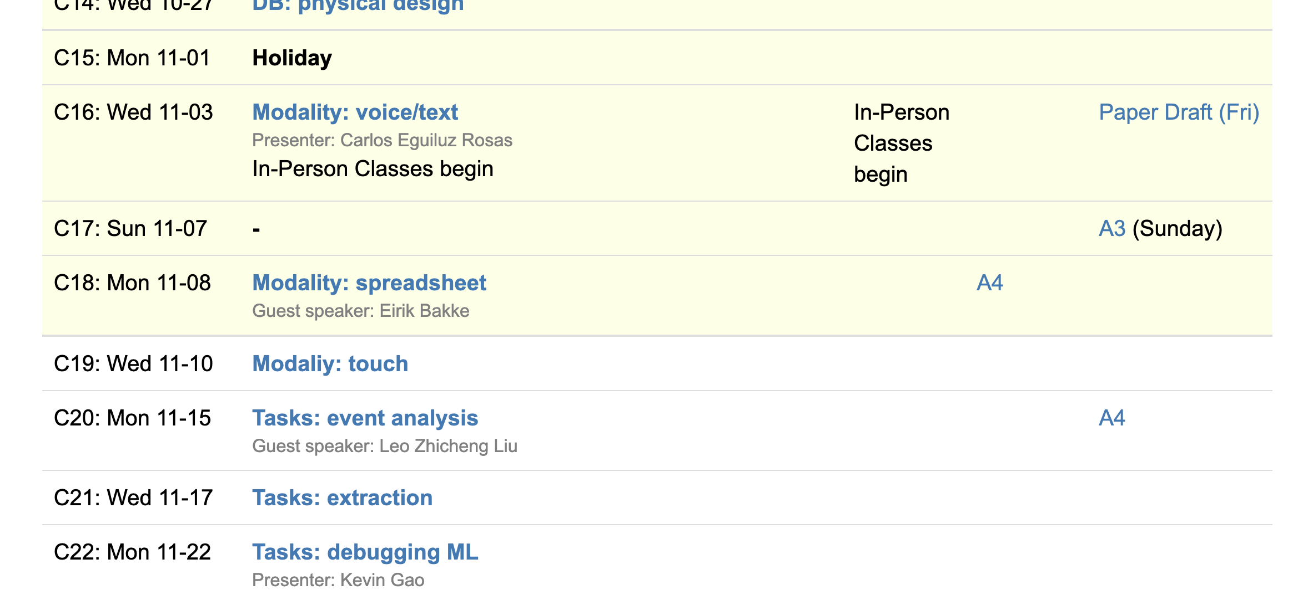
Logistics
Drafts due Friday
A3 due Sunday
A4 out next week
Eirik on Monday

Slide 23
Class 14
Physical Design

Slide 24
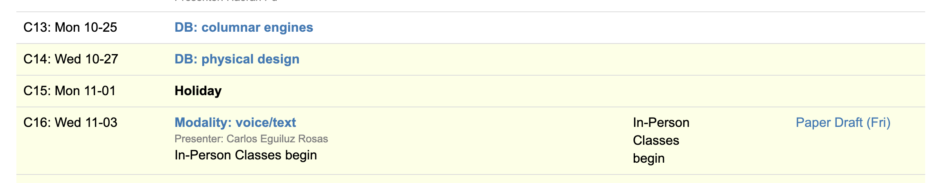
Logistics
In-person-only on Nov 3 after election holiday
Office hours Thursday 1pm (next week only)
Final class on performance
VIS today to Friday

Slide 25
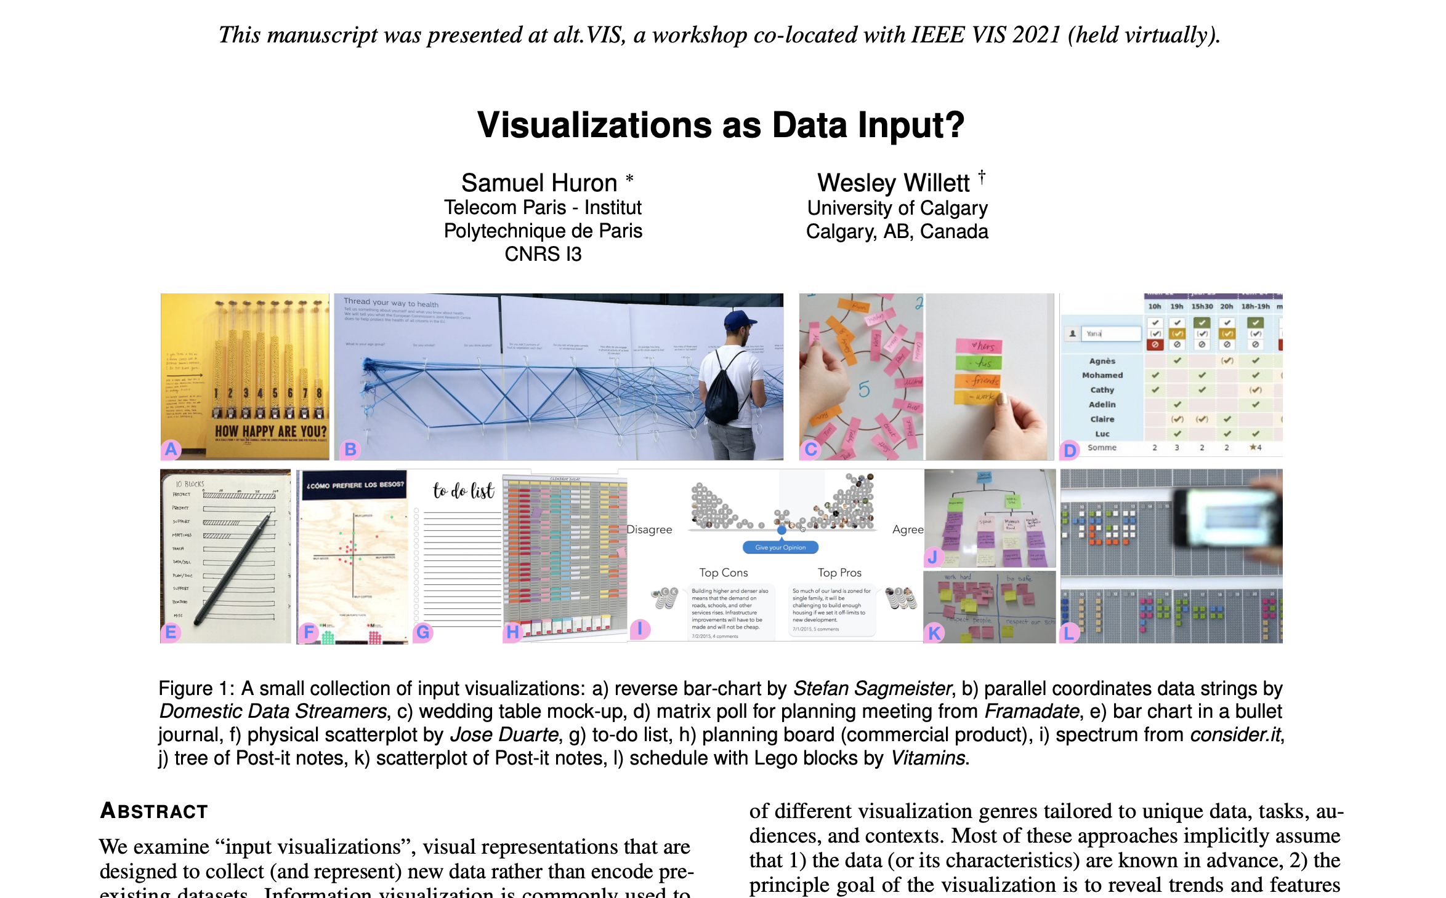

Slide 26
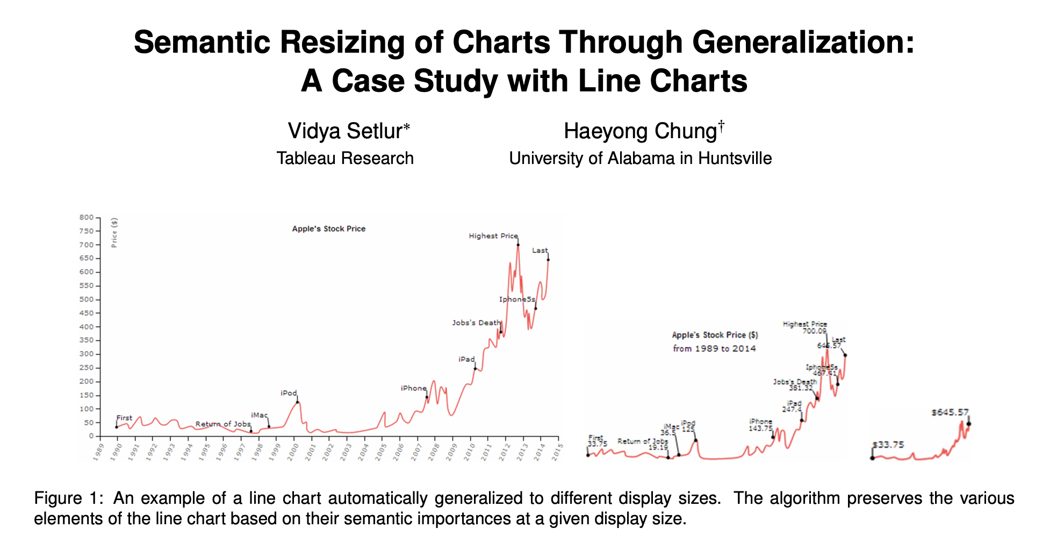

Slide 27
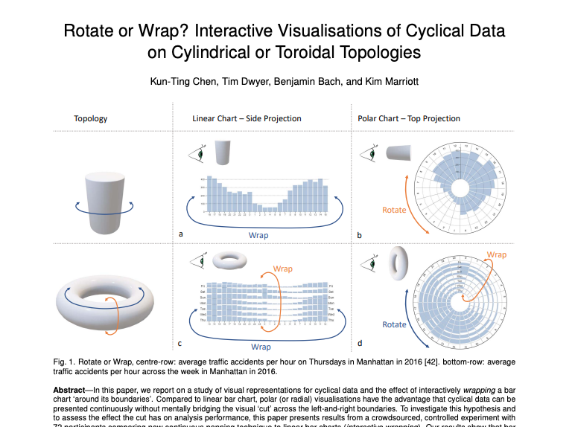
Wrappable Vis (monash.edu)

Slide 28
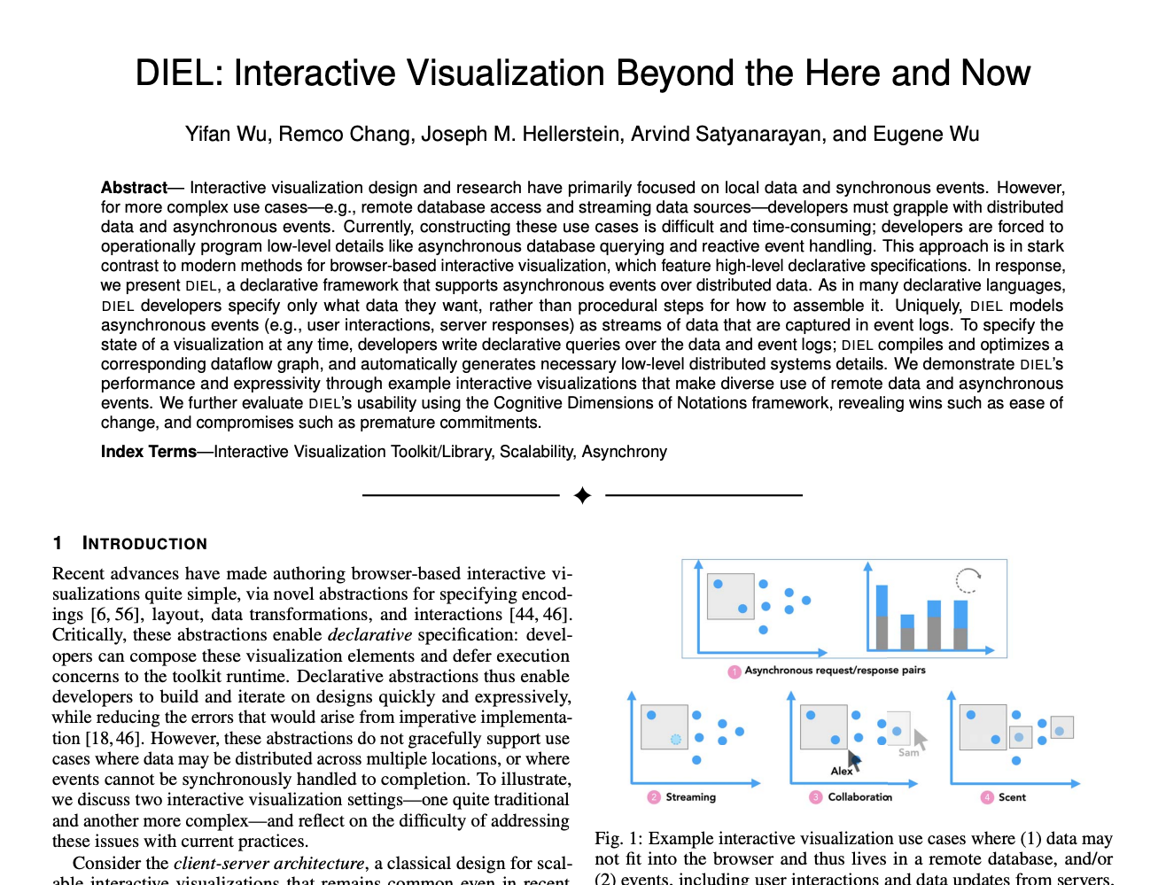

Slide 29

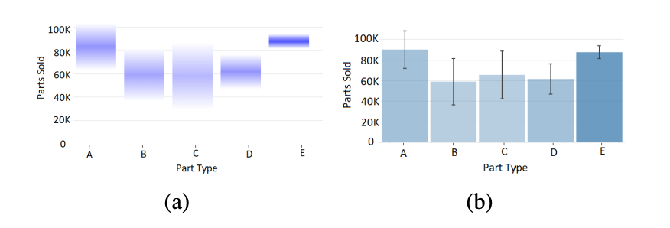

Slide 30
Each group assigns notetaker
What properties from AutoAdmin’s physical design problem are useful for optimizing human data interfaces? What aspects of its optimization problem do NOT apply?
Notes:
How did you pick the other vis language?

Slide 31

Support your colleagues
for speaking up!
2 Thumbs 4 SPEAKING UP

Slide 32
Each group assigns notetaker
What properties from AutoAdmin’s physical design problem are useful for optimizing human data interfaces? What aspects of its optimization problem do NOT apply?
Notes:
How did you pick the other vis language?

Slide 33
Class 13
Columnar Execution

Slide 34
Logistics
In-person-only on Nov 3 after election holiday
Spreadsheet assignment out!

Slide 35
Each group assigns notetaker
The reading mentioned column groups. What factors would determine the “best” column grouping?
Notes:
How did you pick the other vis language?

Slide 36
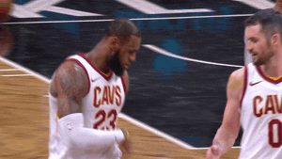
Support your colleagues
for speaking up!

Slide 37
Each group assigns notetaker
The reading mentioned column groups. What factors would determine the “best” column grouping?
Notes:
How did you pick the other vis language?

Slide 38
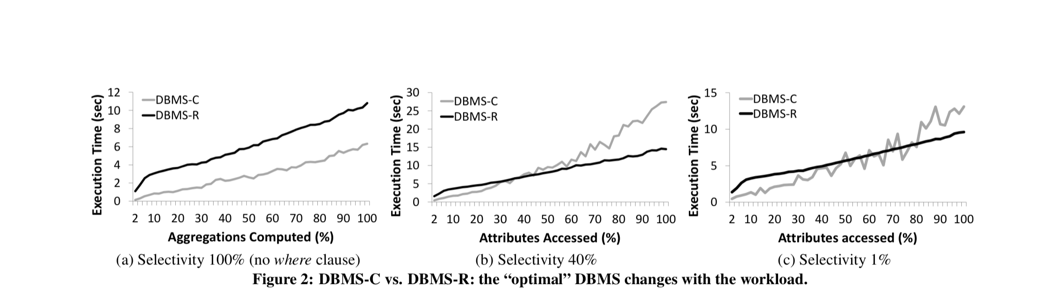
SELECT a, b, …. FROM data WHERE a > ? and b > ? and ….

Slide 39


Slide 40
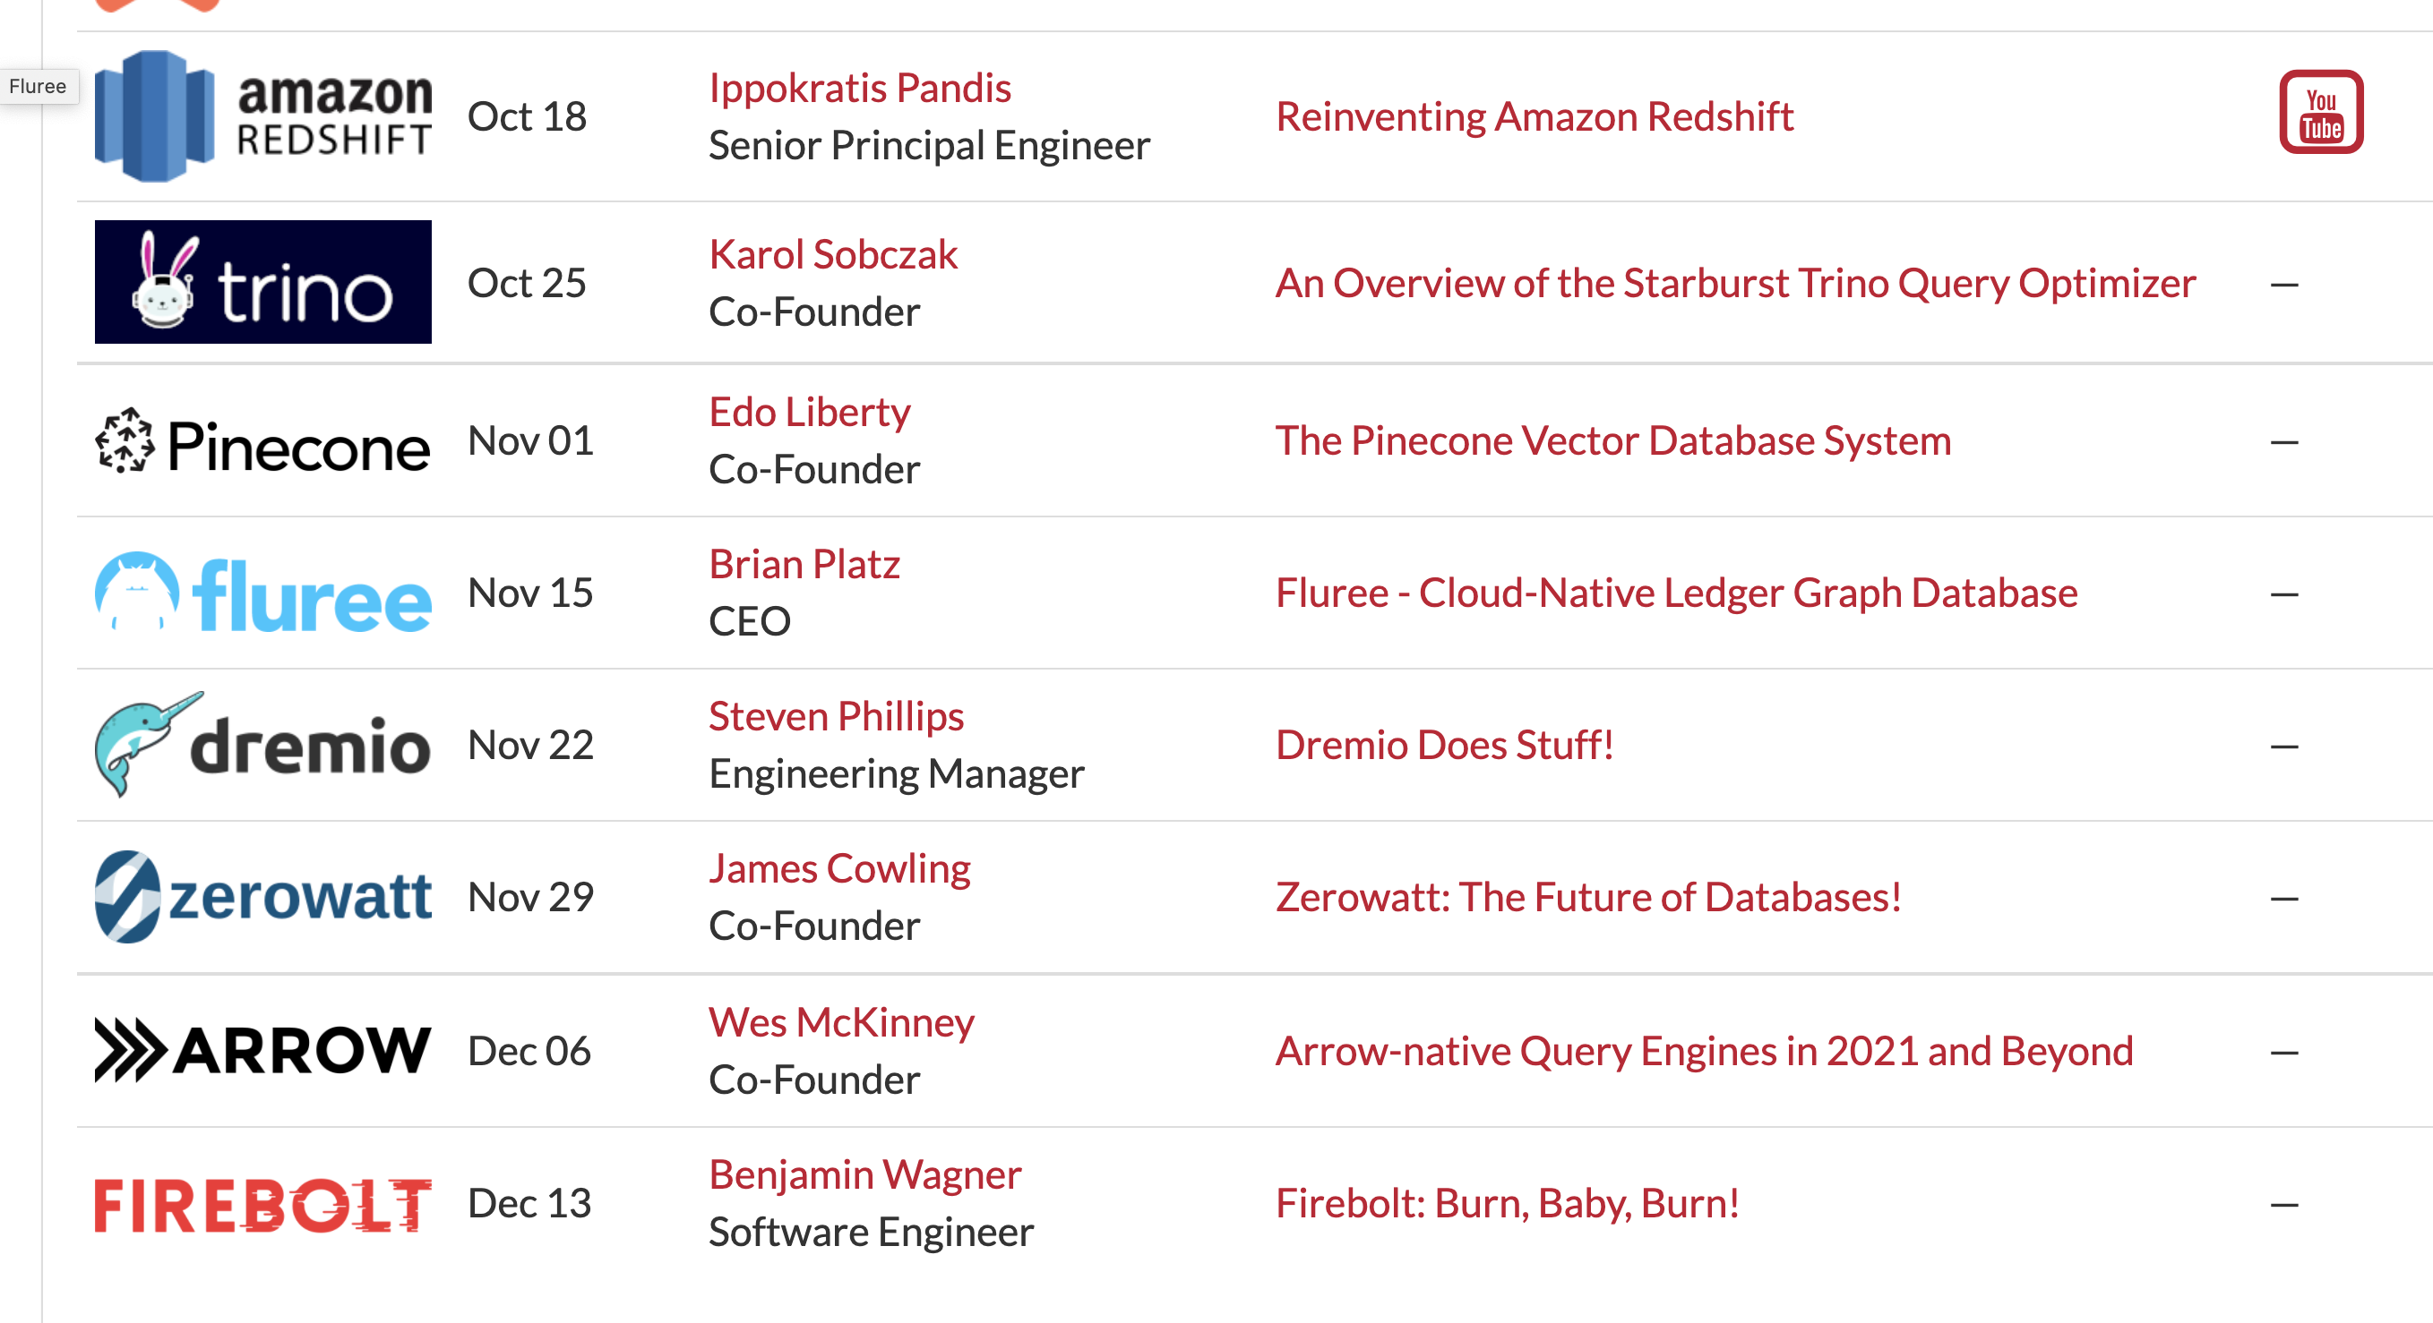

Slide 41
Class 12
Approximation and Materialization

Slide 42
Logistics
Haoran Pu discusses today’s readings
In-person-only on Nov 3 after election holiday
Spreadsheet assignment out Friday

Slide 43
Reviews
Sample creation takes a significant amount of time (5-30 minutes)… It doesn't seem like we would use BlinkDB for analytical workloads in which new data is always incoming.

Slide 44
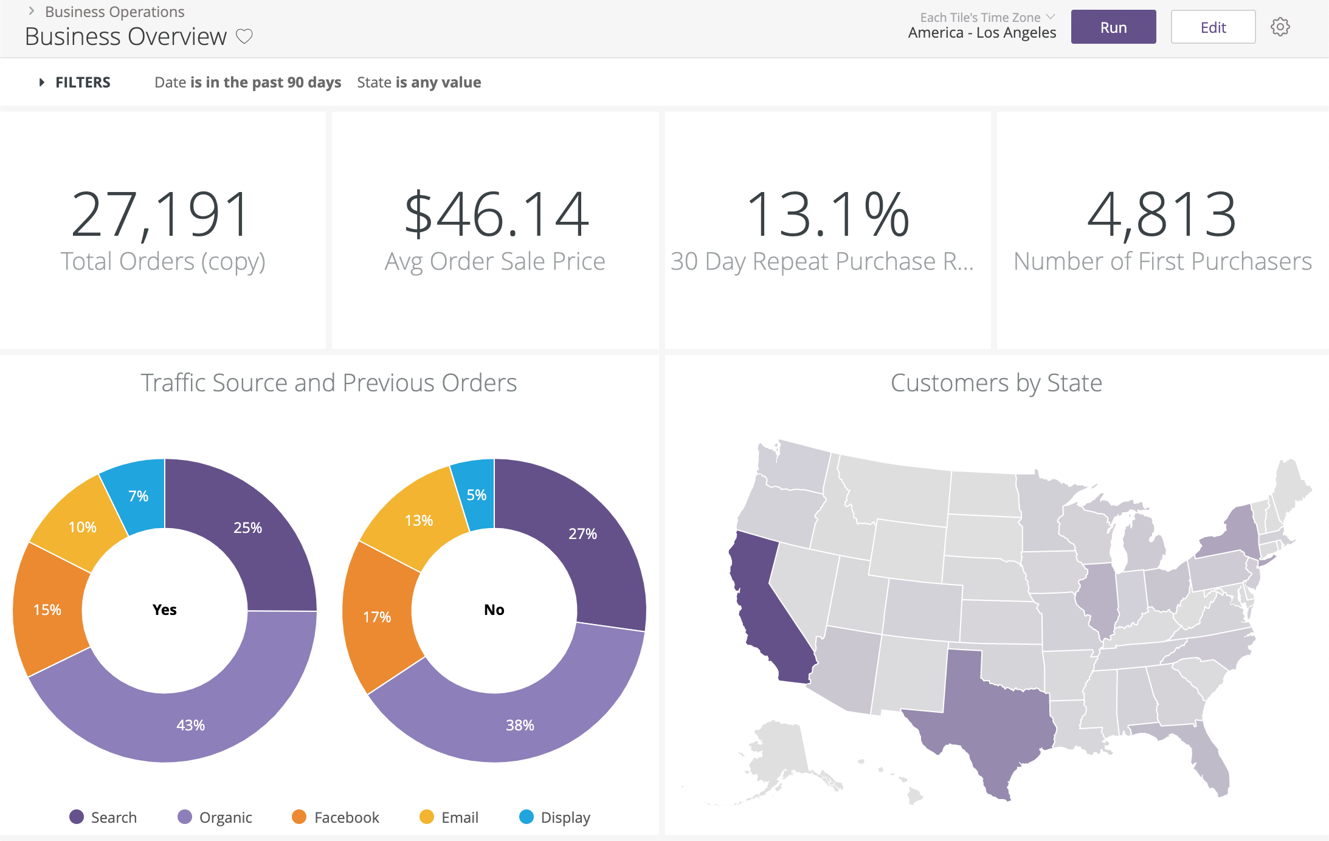
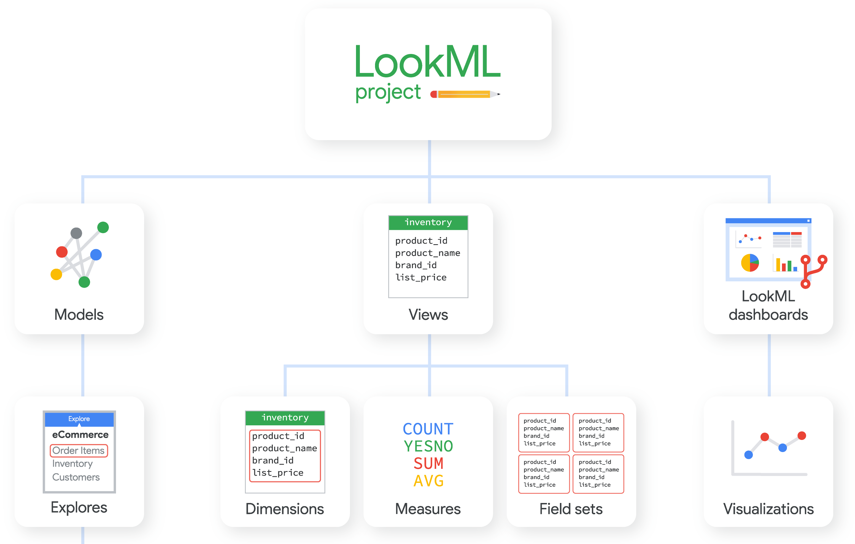
Reviews
Data cubes are no good for non-expert. As users have to define key measurements for the data cube. This means the interface user should be professional rather than a user who just wants to explore the data set.

Slide 45
Malloy from Looker
SQL is complete but ugly:
everything is expressible, but nothing is reusable;
simple ideas are complex to express;
the language is verbose and lacks smart defaults.
explore 'malloy-data.ecomm.order_items' | reduce
status
order_item_count is count(*)
https://github.com/looker-open-source/malloy

Slide 46
Each group assigns notetaker
What interface characteristics make approximation
more applicable than building data cubes (or vice versa)?
​Construct an example
Notes:
How did you pick the other vis language?

Slide 47

Support your colleagues
for speaking up!

Slide 48
Each group assigns notetaker
What interface characteristics make approximation
more applicable than building data cubes (or vice versa)?
​Construct an example
Notes:
How did you pick the other vis language?

Slide 49
Class 11
Optimization Overview and Col Stores

Slide 50
Logistics
Jeffrey Tao discusses today’s readings
In-person-only on Nov 3 after election holiday
Spreadsheet assignment out Friday

Slide 51
Projects
Main feedback
Hypothesis
Narrow scope
Related work
System
User Study
Hypothesis/Question
Interview

Slide 52
Projects
Main feedback
Hypothesis
Narrow scope
Related work
Not Here!
Start HERE!
System
User Study
Hypothesis/Question
Interview
Is it novel?
Is it worth asking?
Is it answerable?

Slide 53
Reviews
Data (model, size, shape)
Queries
Ops supported by interface
Formulas
Query structure/exec plan
User
What’s acceptable (acc, latency)?
What they want (deep vs wide?)
Preferences
Resources
To train user models, precompute, etc

Slide 54
Each group assigns notetaker
WHAT does the developer/user/system need to do
so the optimization system has the necessary information?
G1: to choose between materialized views and AQP?
G2: to know what the user wants/will do?
G3: to know what is acceptable?
Notes:
How did you pick the other vis language?

Slide 55

Support your colleagues
for speaking up!

Slide 56
Each group assigns notetaker
WHAT does the developer/user/system need to do
so the optimization system has the necessary information?
G1: to choose between materialized views and AQP?
G2: to know what the user wants/will do?
G3: to know what is acceptable?
Notes:
How did you pick the other vis language?

Slide 57
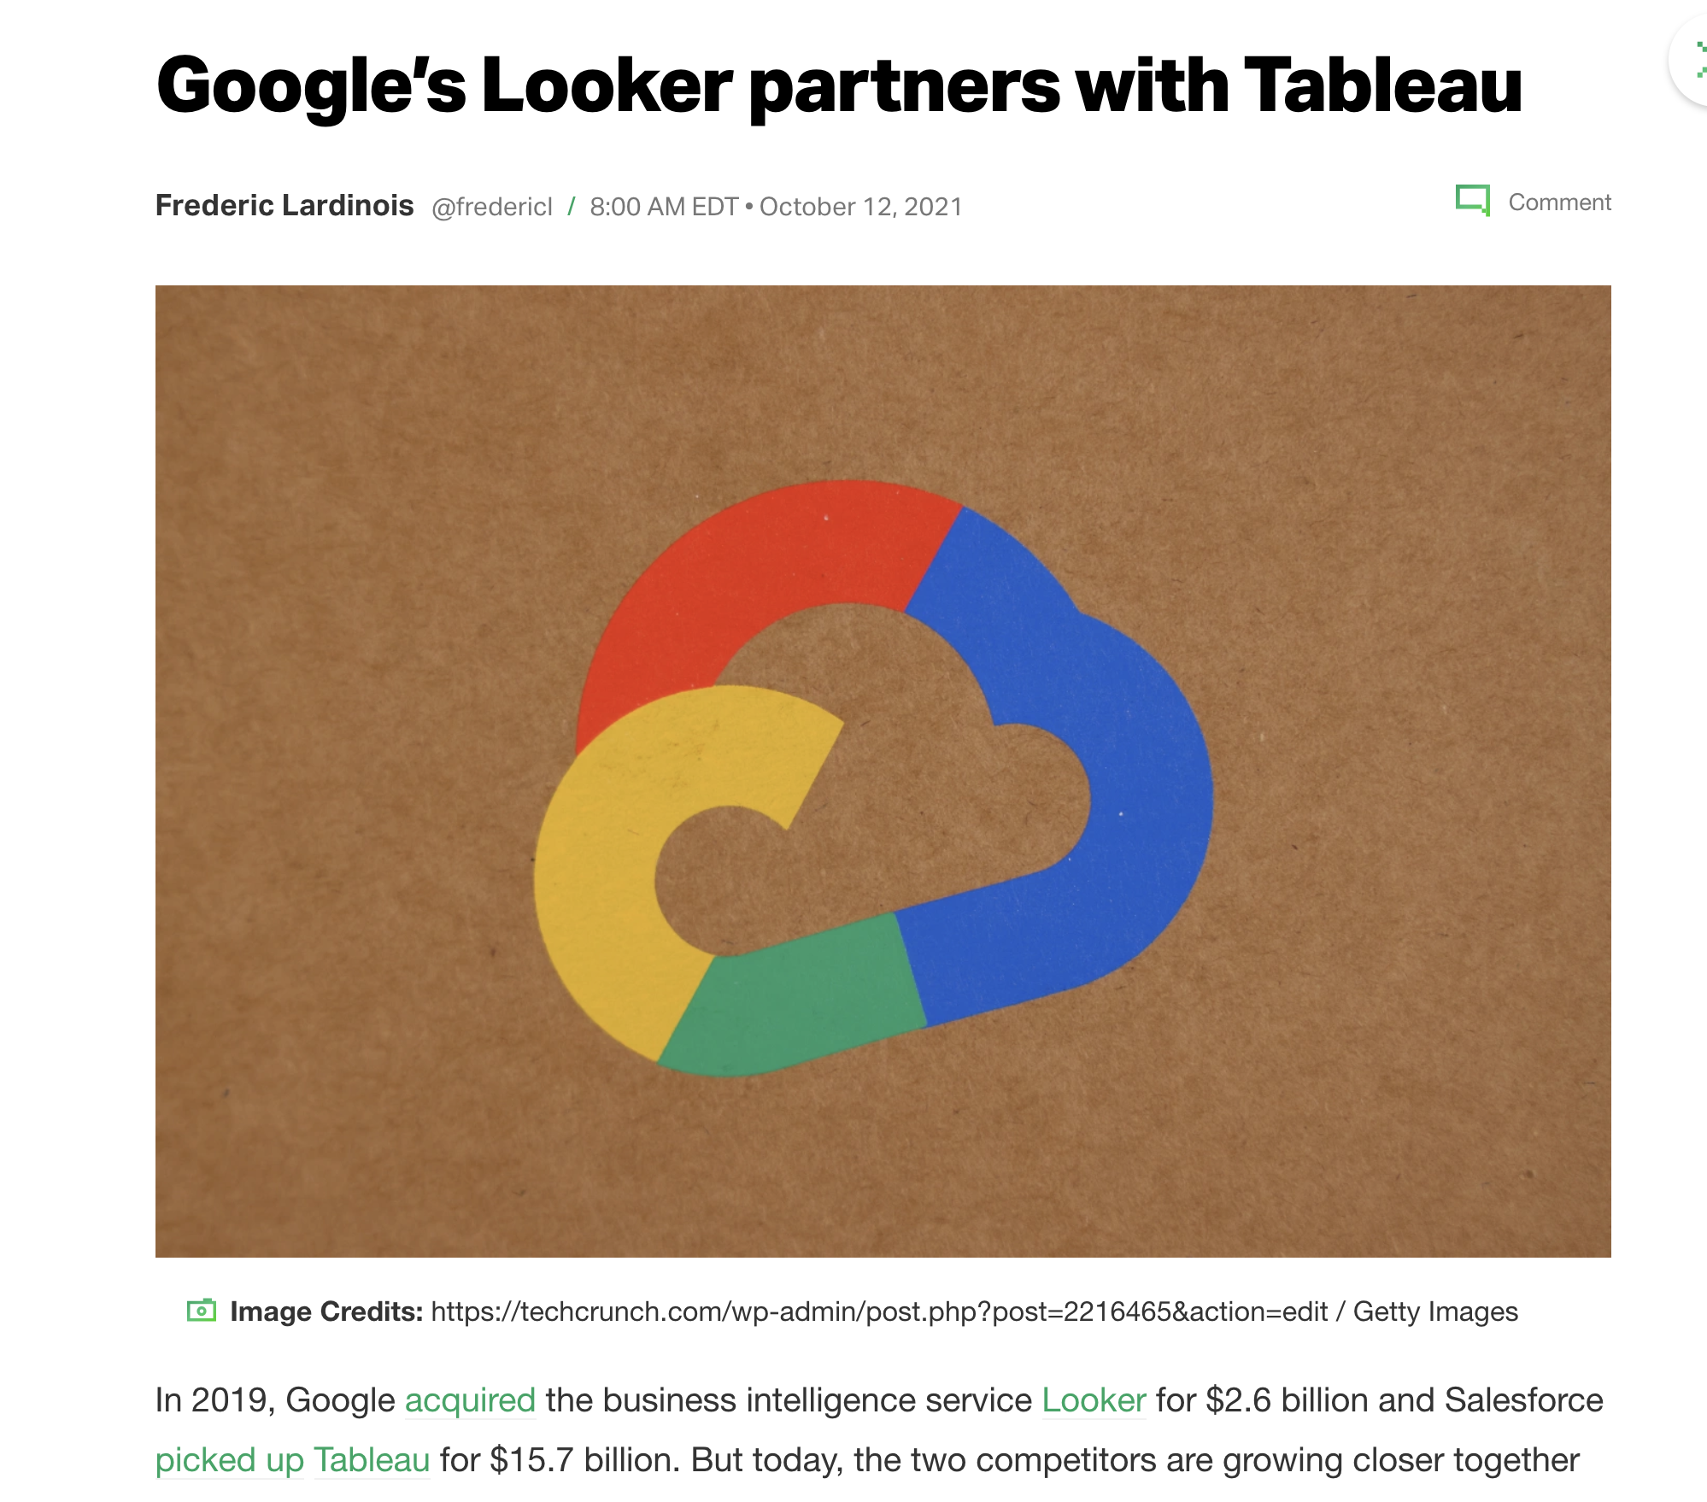

Slide 58
Class 10
Data Perspective on Data Interfaces

Slide 59
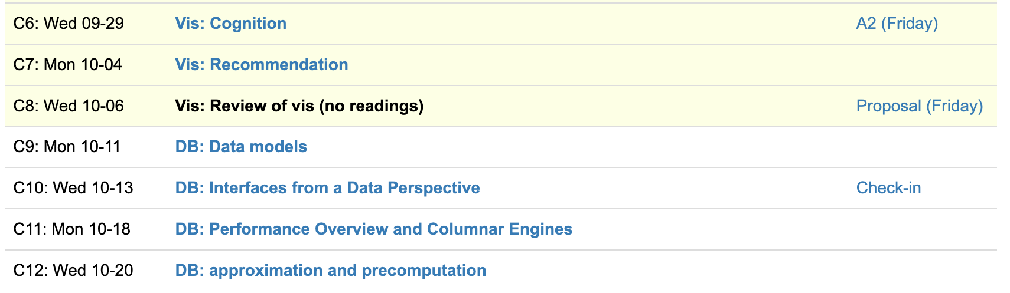
Logistics
Check-ins this week
Presentations starting next week
In-class or not? Votes lean toward in-class. Decision by Friday.

Slide 60
Leo Zhicheng Liu

Slide 61
Each group assigns notetaker
Where does Ermac draw the line between the visualization library and the database? Where does Tableau draw the line?
Notes:
How did you pick the other vis language?

Slide 62

Support your colleagues
for speaking up!

Slide 63
Each group assigns notetaker
Where does Ermac draw the line between the visualization library and the database? Where does Tableau draw the line?
Notes:
How did you pick the other vis language?

Slide 64
Class 9
Data Models

Slide 65
Logistics
Check-ins this week
Shifting to data processing topics
Midterm reviews
Review “grades” out tomorrow

Slide 66
Each group assigns notetaker
Identify an application or interaction that is hard to support under a relational model but easy to support under a non-relational model (specify what model).
Notes:
How did you pick the other vis language?

Slide 67

Support your colleagues
for speaking up!

Slide 68
Each group assigns notetaker
Identify an application or interaction that is hard to support under a relational model but easy to support under a non-relational model (specify what model).
Notes:
How did you pick the other vis language?

Slide 69
Class 8
Review/Breather

Slide 70
Turn video on,
enable mic

Slide 71
Logistics
Proposals due Friday
Sign up for Check-ins for next week (during OH and Thurs)

Slide 72
Each group assigns notetaker
Discuss a potential language for a domain we haven’t read about.
Consider the concepts covered in class so far
Notes:
How did you pick the other vis language?

Slide 73

Support your colleagues
for speaking up!

Slide 74
Each group assigns notetaker
Discuss a potential language for a domain we haven’t read about.
Consider the concepts covered in class so far
Notes:
How did you pick the other vis language?

Slide 75
Class 7
Recs

Slide 76
Turn video on,
enable mic
Is it winter already???
Discuss

Slide 77
Logistics
Proposals due Friday
No reviews Wednesday

Slide 78
Each group assigns notetaker
In human data interfaces, what should be the role of recommendations? What tasks?
Construct a scenario. Discuss the gaps wrt the readings.
Notes:
How did you pick the other vis language?

Slide 79

Support your colleagues
for speaking up!

Slide 80
Each group assigns notetaker
In human data interfaces, what should be the role of recommendations? What tasks?
Construct a scenario. Discuss the gaps wrt the readings.
Notes:
How did you pick the other vis language?

Slide 81
Class 6
Cognition

Slide 82
Turn video on,
enable mic
What is your favorite
sandwich (broadly construed)

Slide 83
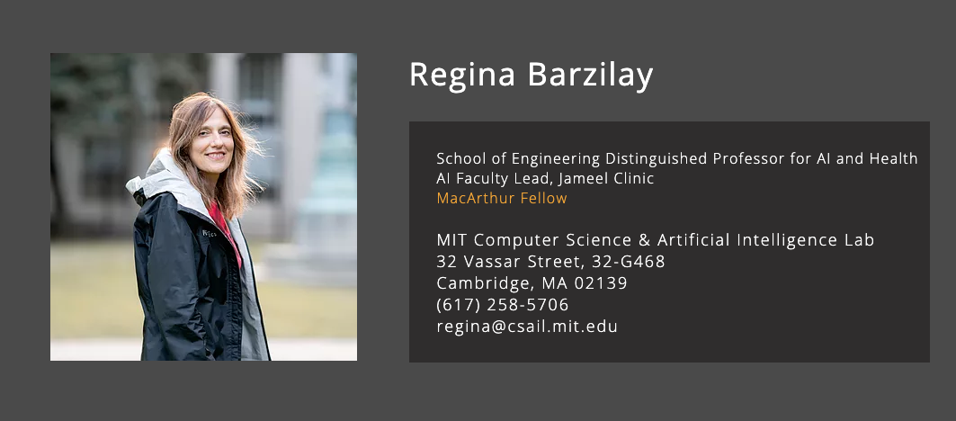
CS Distinguished Lecture
Mon 10/4 11:30AM

Slide 84
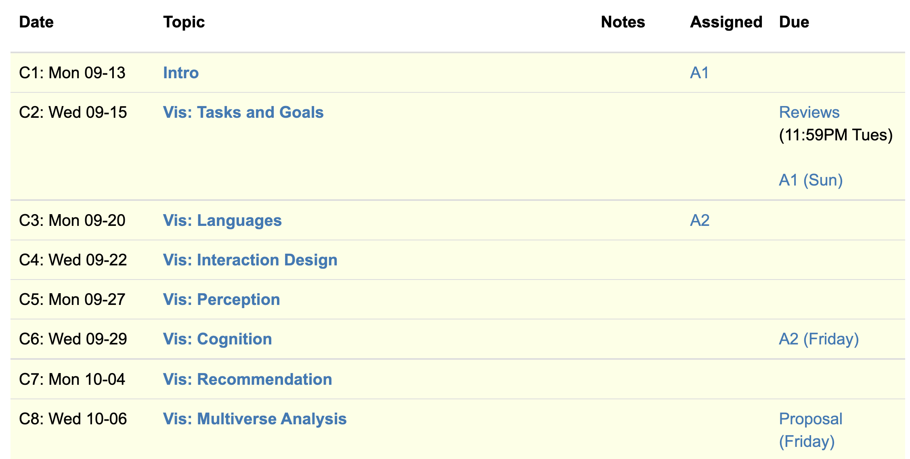
Logistics
A2 due Friday, Proposals next Friday
2nd guest speaker: Leo from Graphistry

Slide 85
Eirik Bakke: Spreadsheets

Slide 86
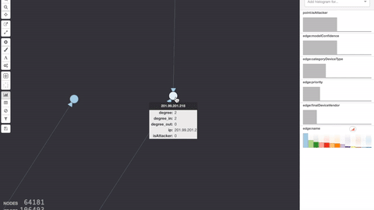
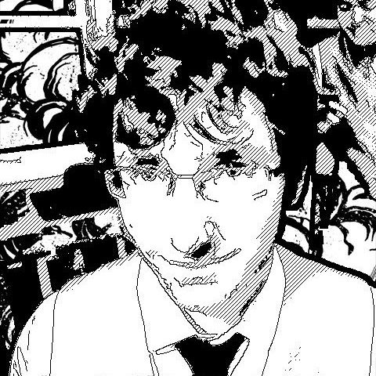
Leo Meyerov: Graph Analytics via GPU

Slide 87
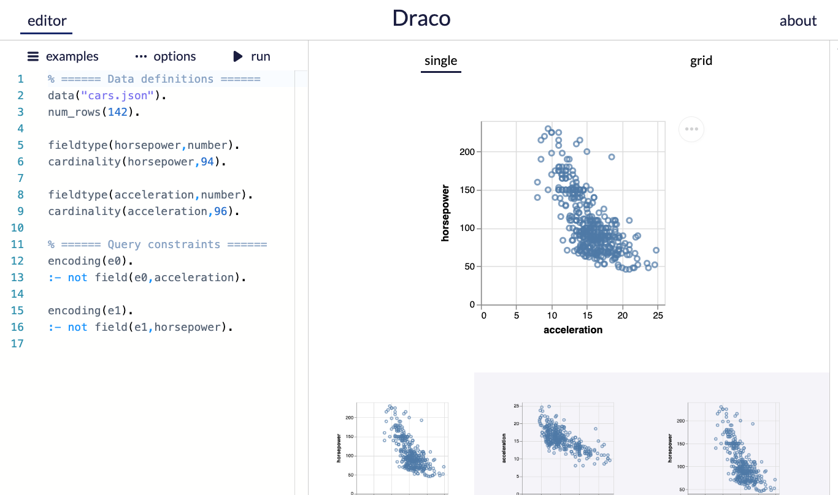
A2
Use the draco demo editor
Paper describes ASP language

Slide 88
Bridging Ideas and Reality
CS is (mostly) an engineering discipline
Ideas are ambiguous, many ways to ground in reality
“Draco could make data scientist lives better”
Project proposal: disambiguate.
Hypothesis formulation: a way to disambiguate

Slide 89
Overview. Research Project 50%
BAD
“We want to build X with features A, B, C”
Ignores why it’s worthwhile and new
Confuses artifact as the goal
GOOD
“Evidence shows Y is important, but existing work have a gap in X. We show that to fill the gap, A, B, and C and needed”
Grounded in related work and user needs
Explains why A, B, and C are necessary

Slide 90
Overview. Research Project 50%
BETTER
“Evidence shows that Y is imptnt, but existing work have a gap in X. ”
“If we do A, then we expect METRIC to CHANGE”
“If we do B, then we expect METRIC to CHANGE”
…

Slide 91
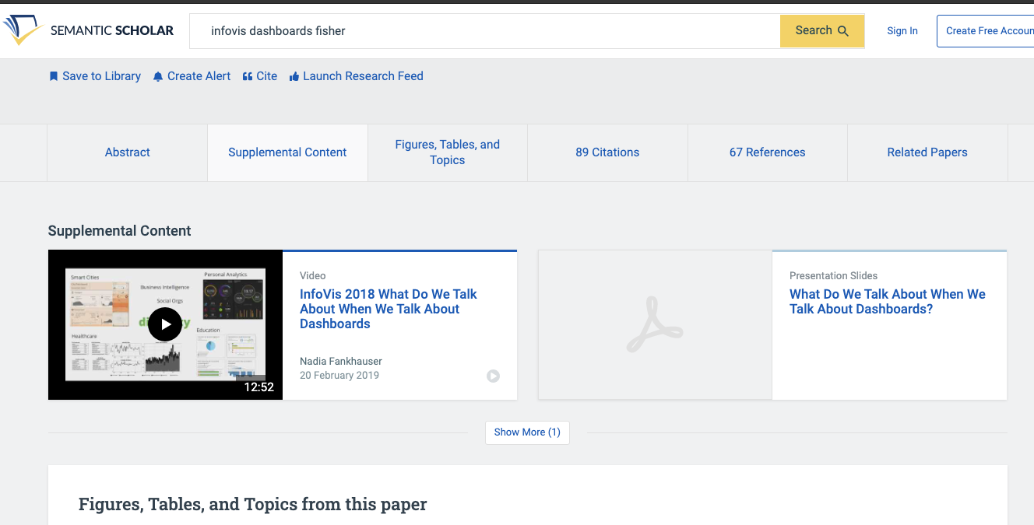

Slide 92
Each group assigns notetaker
This paper applied bayesian cognition to estimating a mean value. Identify another vis setting where the model could be applied. Formulate a hypothesis and sketch an experiment design.
Hypothesis: “Given conditions A, B is METRIC different?”
Notes:
How did you pick the other vis language?

Slide 93
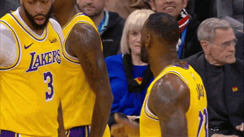
Support your colleagues
for speaking up!

Slide 94
Each group assigns notetaker
This paper applied bayesian cognition to estimating a mean value. Identify another vis setting where the model could be applied. Formulate a hypothesis and sketch an experiment design.
Hypothesis: “Given conditions A, B is METRIC different?”

Slide 95
Class 5
Perception

Slide 96
Turn video on,
enable mic
What’s your favorite restaurant
within a 20 min radius?

Slide 97
Logistics
A2 due Friday
Think about project proposal. 2 office hours left!

Slide 98
Projects
Build a system
Design an algorithm
Evaluate a design
Study perception/cognition
Survey
Etc.
Some project ideas

Slide 99
Today
Background:
Cleveland & McGill
AMT
Example of another perception experiment
The paper!

Slide 100
How complex?
uh...kind of complex?
Visualization Complexity Score
(this paper)
0.01
0.83
Visual complexity is subjective
Hard to articulate
Notes:
It is clear that the complexity of the chart can affect how easily , and accurately the user can extract information from the chart, at a glance.
We could imagine simplifying or zooming in or smoothing a line chart if it’s too complex, but we need to know that it IS too complex first. But what does complex even mean? Visual complexity can be subjective, and we can’t directy ask users to quantify it for us
This paper proposes ONE possible visualization complexity score, that takes a line chart as input and outputs a score that measures its perceptual complexity. For instance, a lower score for the simple horizontal line, and a higher number of a bunch of squiggles.

Slide 101
Adding Synthetic Noise
Notes:
In this experiment, we start with several simple, representative signals and measure their PAE. We see the line has very very low PAE, and it increases with the complexity of the signal.
We then add random synthetic noise to the signals, and see that the entropy correspondingly increases.
In fact, if we plot the amount of noise on the x axis, and the PAE on the Y axis, we see that there is a very strong correlation
Using this methodology, we find that PAE is correlated with synthetic noise. Now synthetic noise doesn’t necessarily correspond with perceived complexity

Slide 102
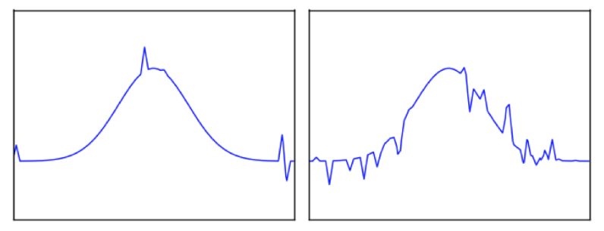
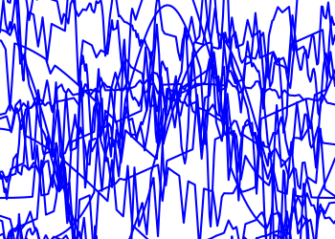
Task: Pick the Original
Glance time
Initial chart shown
Pause time
Mask shown
Pick time
User picks options
Notes:
If you glance over as the visualization changes, can you identify if something changed?
Mask to “clear the perceptual cache” to make sure its due to cognitive rather than low level perceptual pattern matching (after effects)
~3-4 seconds pick time in practice

Slide 103
Ready?
3
2
1

Slide 104
Pick the Original
Accuracy
Reduced
Increased
Change in PAE
Notes:
52 users, randomized order.

Slide 105
Pick the Original
Accuracy
Reduced
Increased
Change in PAE
Initial PAE

Slide 106
Pick the Original
Accuracy
Reduced
Increased
Change in PAE
Initial PAE
Notes:
It’s reminiscent of JND, but is not a formal staircase study
We also evaluated the effects of glance time and the results are reported in the paper.
(H3.1) Entropy of the initial chart (Z = 2.42, p < 0.05);
(H3.2) Magnitude of PAE difference between the two charts (Z = −5.08, p < 0.001);
(H3.3) Sign of the PAE dif- ference between the two charts (Z = −8.06, p < 0.001); and
(H3.4) Baseline function (χ2(3) = 9.32, p < 0.05).
There were 52 participants

Slide 107
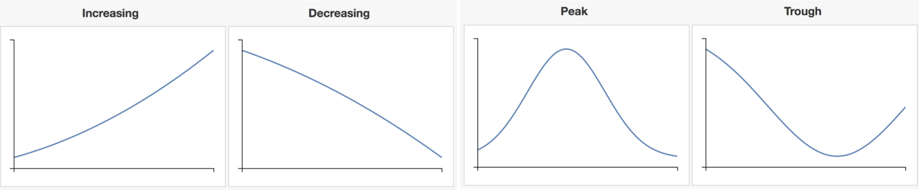
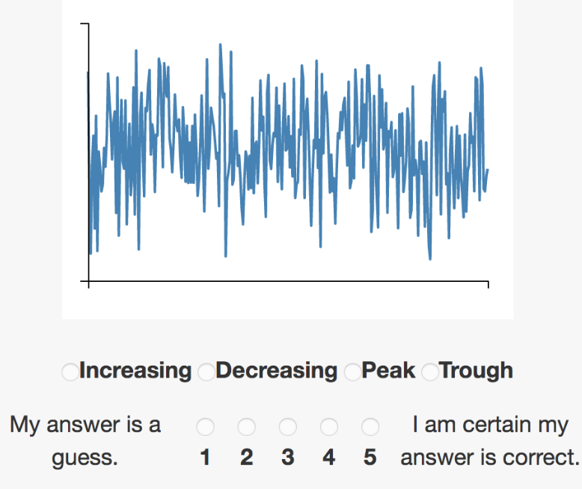
Pick The Signal
Which base function is most representative of chart?
Notes:
500ms glance time (2-4 fixations)
47 total participants,

Slide 108
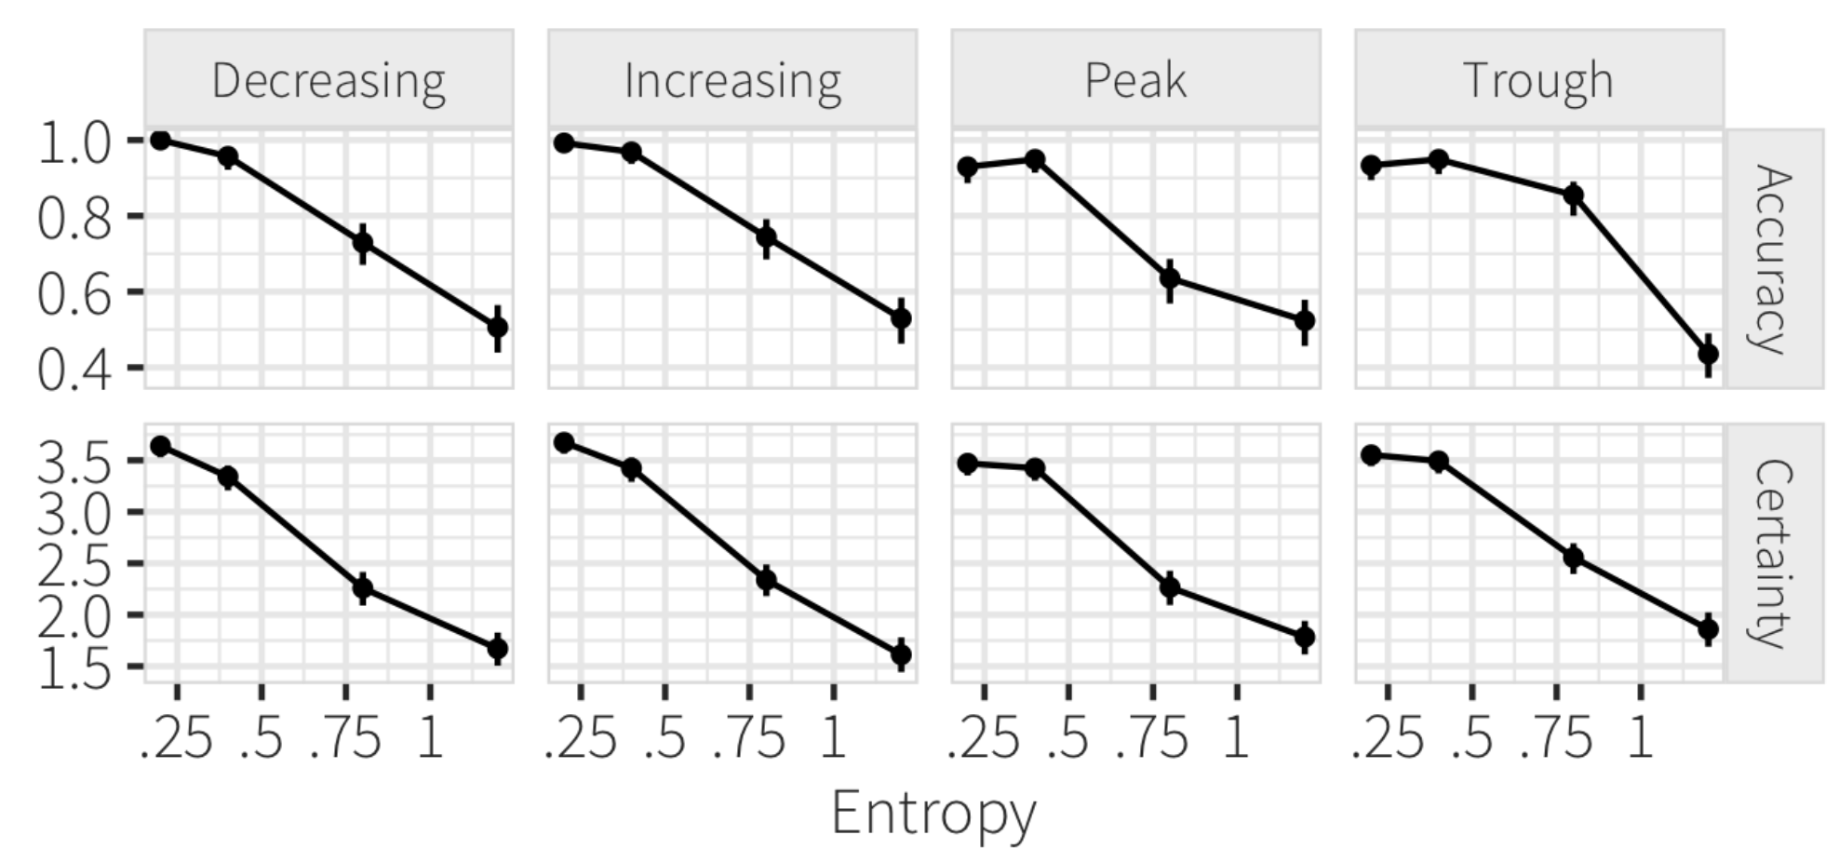
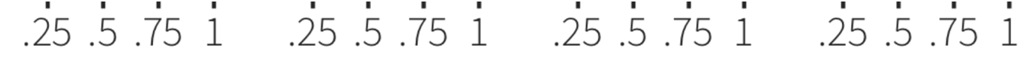
Pick The Signal
PAE
PAE
Notes:
significant results, with clearly high effect size (Z = 25.75, p < 0.001)
For each base function, we showed users 5 versions at each of four PAE levels (0.2, 0.4, 0.8, 1.2), resulting in a 4 × 4 × 5 = 80 factorial design.
There were 47 total participants,

Slide 109
Each group assigns notetaker
What would be a possible follow-up or alternative graphical perception study? Phrase it in the form of a question, and design an experiment for it.
Notes:
How did you pick the other vis language?

Slide 110
Support your colleagues
for speaking up!

Slide 111
Each group assigns notetaker
What would be a possible follow-up or alternative graphical perception study? Phrase it in the form of a question, and design an experiment for it.

Slide 112
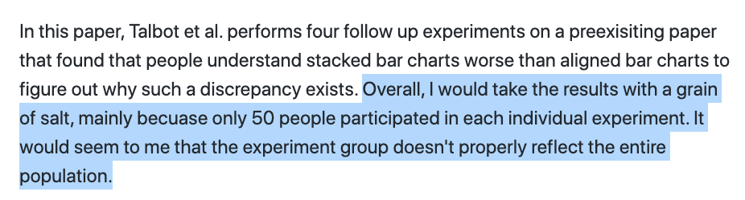

Slide 113
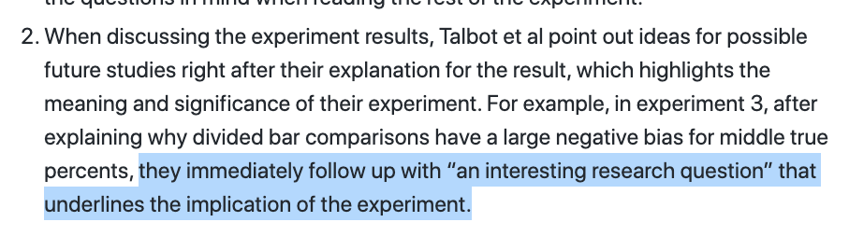

Slide 115
Class 4
Languages, Interaction

Slide 116
Turn video on,
enable mic
Share a book you recently
read/listened to

Slide 117
Logistics
A2 released.
Think about project proposal. 2 office hours left!

Slide 118
Each group assigns notetaker
G1: How does the instrumental interactions model apply to interactive visualizations?
G3, 4: Where do interface languages fit into the instrumental interactions model?
Notes:
How did you pick the other vis language?

Slide 119

Support your colleagues
for speaking up!

Slide 120
Each group assigns notetaker
G1, 2: How does the instrumental interactions model apply to interactive visualizations?
G3, 4: Where do interface languages fit into the instrumental interactions model?

Slide 121
Interactive Interfaces as Domain Specific Languages

Slide 123
Class 3
Languages

Slide 124
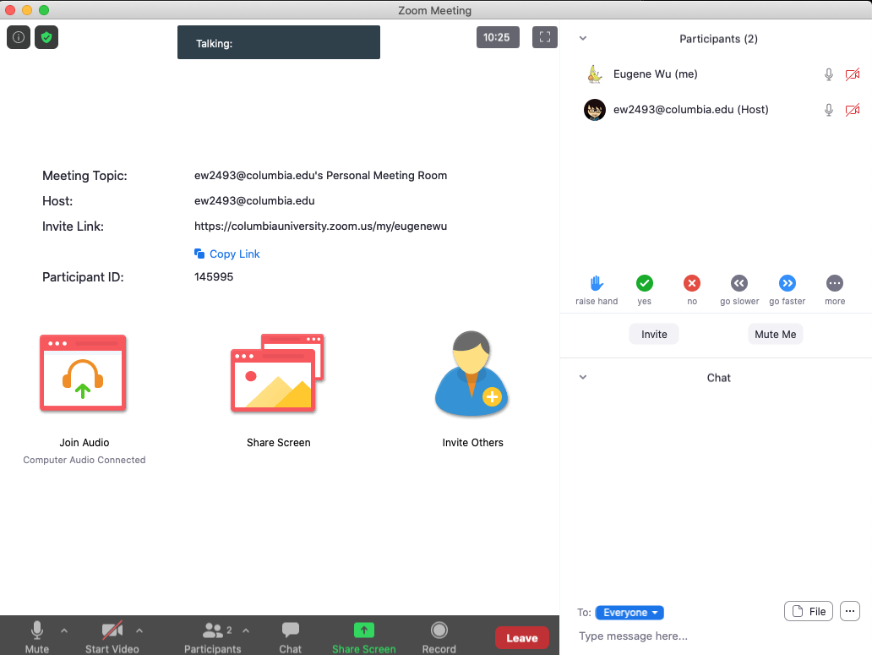

Turn video on,
enable mic & say:
“Hi, this is _(name)_,
I usually eat ________ for lunch”
Click when done
Participants
Chat

Slide 125
Logistics
A1 was due last night
A2 released.

Slide 126
Each group assigns notetaker
G1 and 2: What criteria makes a HDI language good? Put the criteria into action: pick a domain/task and make up a language.
G3 and 4: discuss the strengths and weaknesses of how the paper is communicated. Share the top strength and top weakness.
Notetaker shares what you came up with and the process.
Notes:
How did you pick the other vis language?

Slide 127
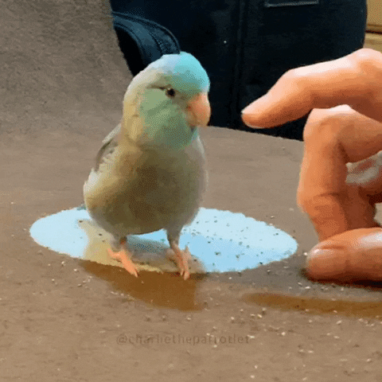
Support your colleagues
for speaking up
A quick thanks or follow up
is great

Slide 128
Each group assigns notetaker
G1 and 2: What criteria makes a HDI language good? Pick a domain/task and come up with a language.
G3 and 4: discuss the strengths and weaknesses of how the paper is communicated. Share the top strength and top weakness.
Notetaker shares what you came up with and the process.

Slide 129
Technique
Is it correct?
Does it make sense?
Is it as simple as possible?
Are decisions unnecessarily complex?

Slide 130
Comunication
What is the appropriate audience?
How well do they justify
Design decisions?
Technical approach?
The problem itself?

Slide 131
Experiments
What SHOULD have been done?
How should it be measured?

Slide 132
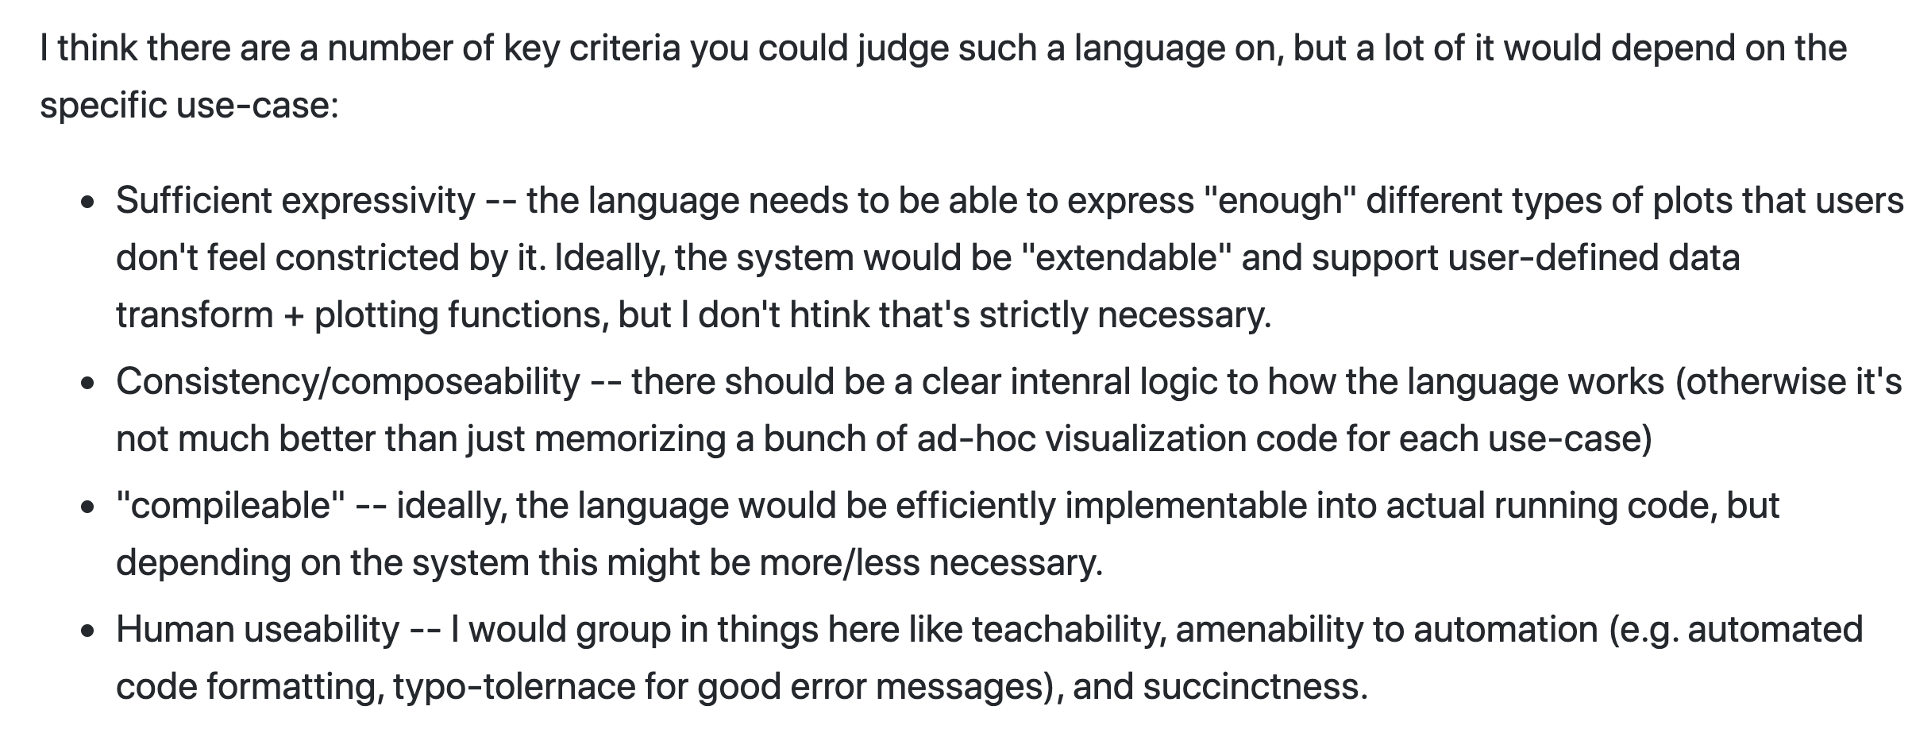

Slide 133
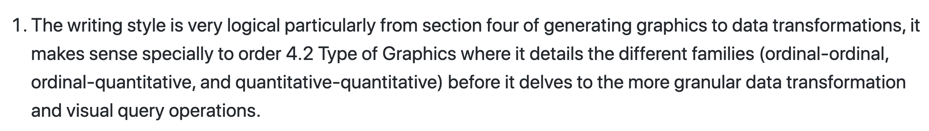

Slide 134
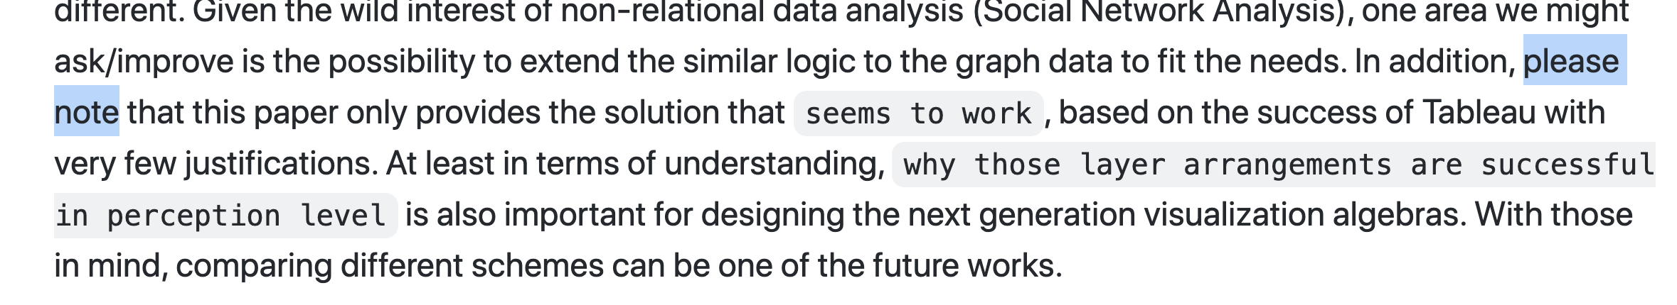

Slide 135
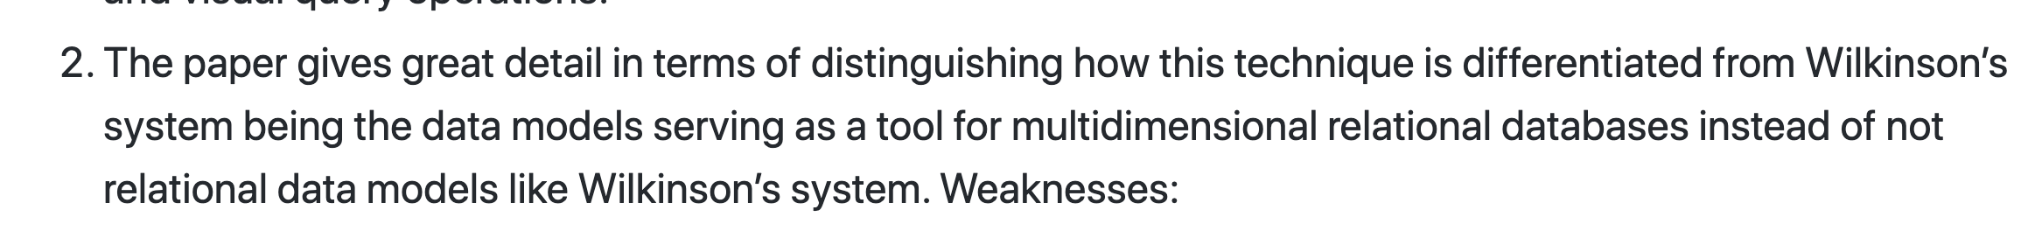

Slide 136
Class 2
Tasks

Slide 137
Discussion prompt:
Recent book that you find memorable

Slide 138


Slide 139
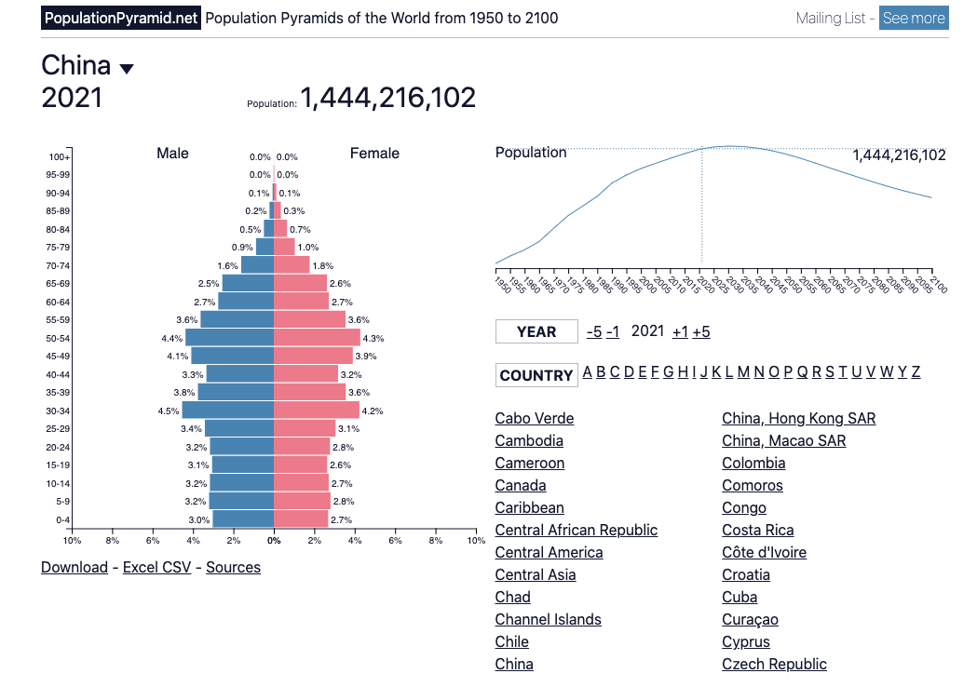

Slide 140
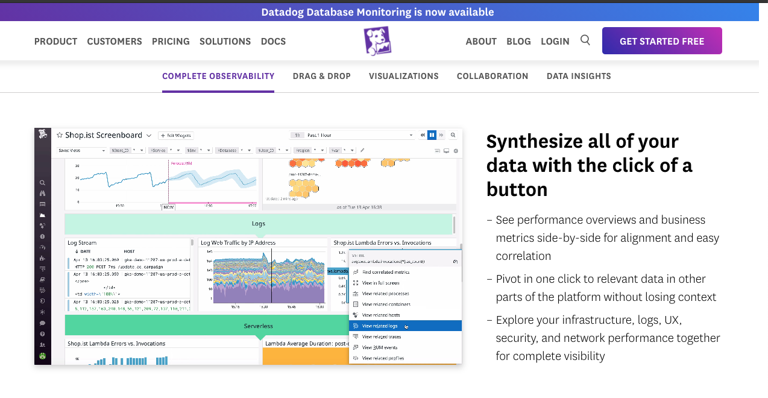

Slide 141
Each group assigns notetaker
Groups of 4:
You back-fitted task descriptions from a visualization. Discuss your process, what made it easy/difficult, and reflect on the applicability of the task typology.
Bonus, choose a visualization and task to share with the class. (connect to zoom, share screen)

Slide 142
Support your colleagues
for speaking up
A quick thanks or follow up
is great

Slide 143
Each group assigns notetaker
Groups of 4:
Discuss and share the visualization and task description you created in the review.
Choose one that notetaker will share with the class
(connect to zoom, share screen)

Slide 144
TODOs
A1!!

